Slide 1

PROJECT
Fares Nageh Abdelaal Abdelaal
C3 45
Mohamed Hamdi Basuoni Awaad
C4 17
Supervised by: Eng.Omar Khaled

Slide 2
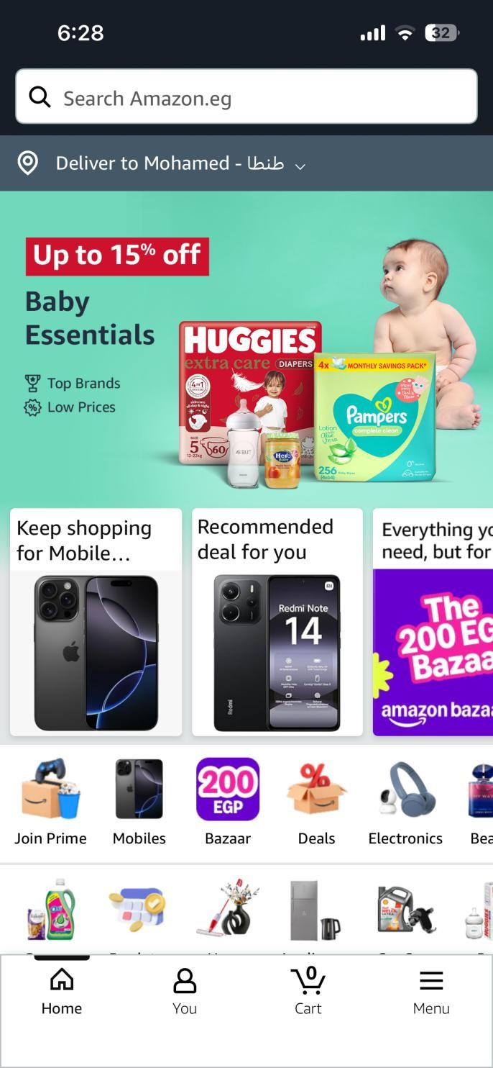
BEFORE MODIFICATION: Home Screen
Too many things on screen: The screen has too many banners
and products, which makes it messy.
Hard to think: Users need extra effort to understand where to start
because of high cognitive load.
Distracting ads: Many advertisements appear at the same time,
causing confusion.
Small icons: Navigation buttons are too small and not clear to see.
No clear order: There is no clear focus to guide the user's eye to important items.
Hard to read: Information is crowded, which reduces reading speed.

Slide 3
Violated HCI Principles:
Aesthetic and Minimalist Design: The design is not simple and has too much clutter.
Visibility: Important information and buttons are hidden or not clear.
Utility: The system does not provide enough tools to help users make a good choice.
Efficiency of use: It takes too much time to find what the user wants.

Slide 4
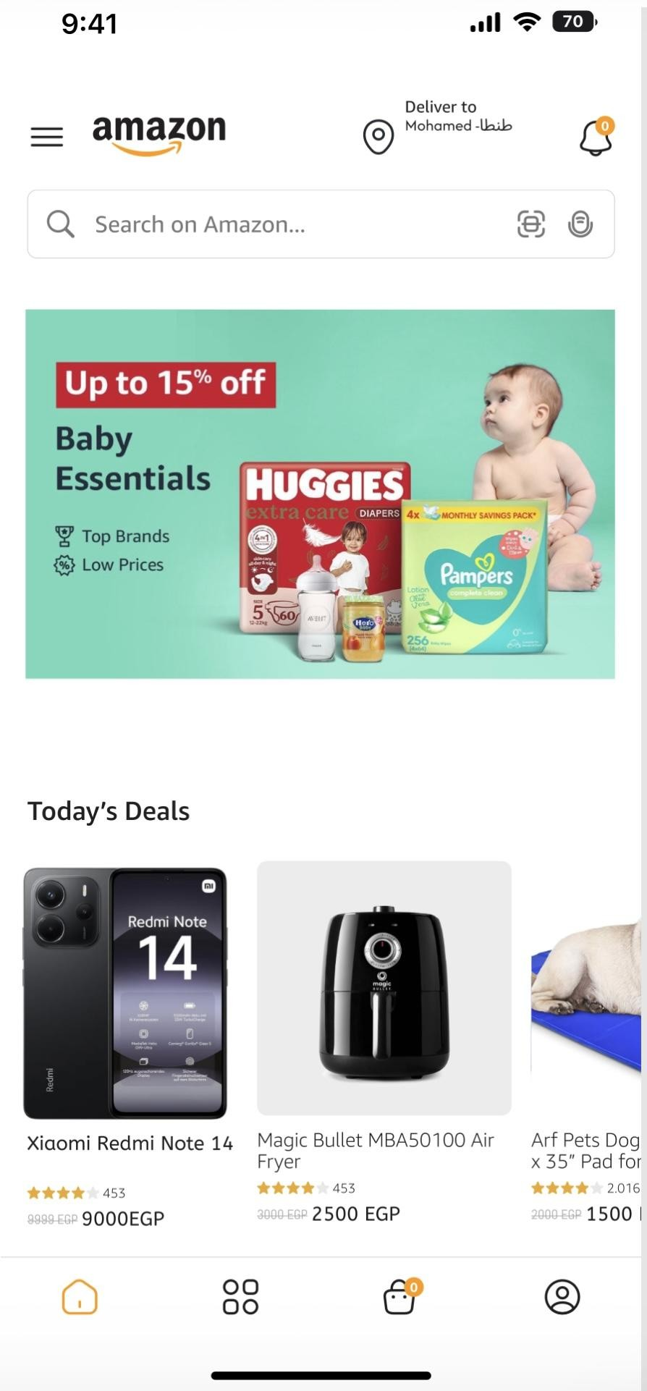
AFTER MODIFICATION: HOME SCREEN
Clean and simple layout: Removed extra elements to make the screen neat.
Less clutter: Reduced the number of items to help the user focus.
Clear hierarchy: Important items are now big and easy to find first.
Better navigation: Icons are clear and have labels to guide the user.
Easy to see: Main content is highlighted so the user knows what to do next.
Recognition: Users can quickly recognize icons without hard thinking.

Slide 5



UX IMPROVEMENT _ HOME SCREEN :⯈
Find things faster: The new design improves Efficiency, so users find products in less time.
Less mess to focus: Removing visual clutter follows the Aesthetic and Minimalist Design principle.
Guides the eye: Using a clear hierarchy makes important information have better Visibility.
Easy to learn: New users have a lower cognitive load, which makes the app very easy to learn.
Simple moving: Users move between sections easily because of improved navigation clarity.
Better Recognition: It is easier for users to recognize icons than to remember them from memory.

Slide 6
COMPARISON _ HOME PAGE
Before | After
Too much visual clutter | Minimalist Design and clean layout
No clear visual hierarchy | Better Visibility to guide the eye
Distracting ads causing confusion | Better focus on main products
Distracting ads causing confusion | Navigation clarity for easy moving
Small and unclear icons | Improved Efficiency and faster use

Slide 7
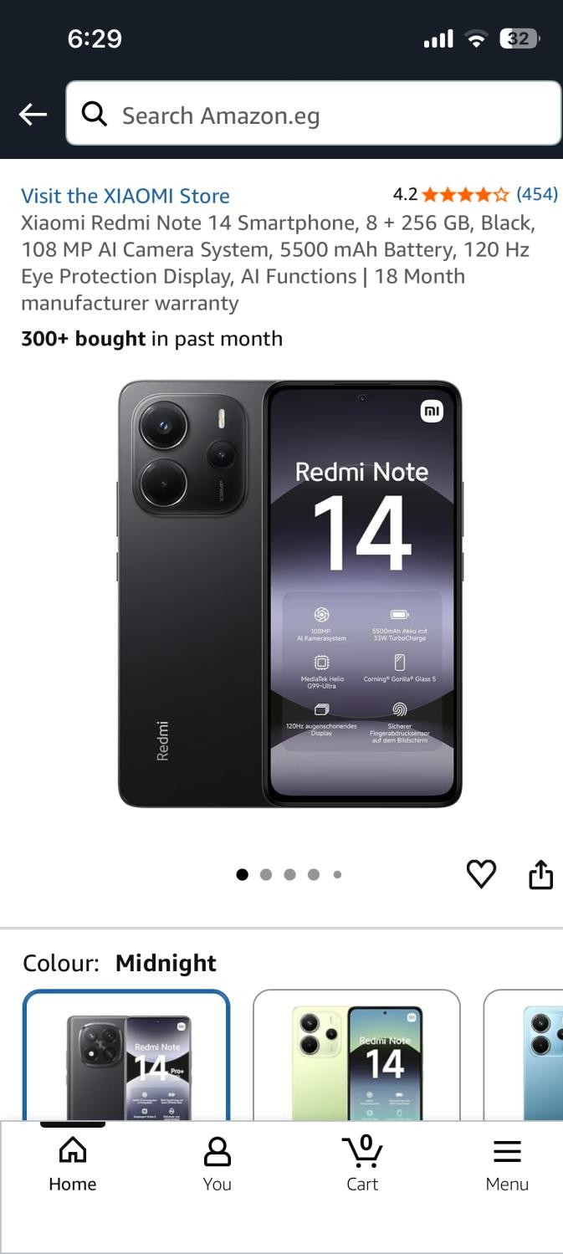
BEFORE MODIFICATION _ PRODUCT PAGE
Crowded screen: Too many elements close together.
Main action hidden: The "Add to Cart" button is not clear.
2D Limitation: Only flat photos, no real size view.
Hard to scan: Users struggle to find the price and details.
Risk of mistakes: Users might buy the wrong size.

Slide 8
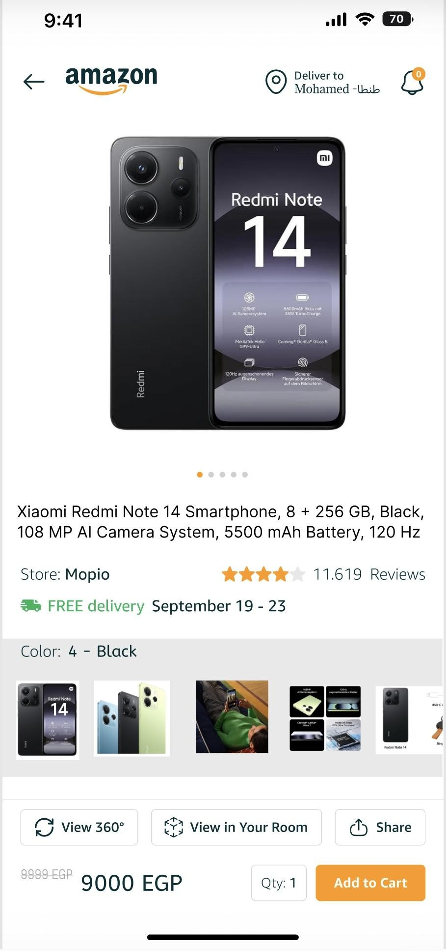
AFTER MODIFICATION _ PRODUCT PAGE
Large images: Clearly shown at the top.
Added AR: "View in Your Room" helps see real size.
360° View: Provides a spatial experience.
Visible button: Large orange "Add to Cart" button.
Good spacing: Makes reading faster and easier.

Slide 9
UX IMPROVEMET _ PRODUCT PAGE
Faster decisions: AR helps users choose quickly.
Better Visibility: Important info is now very easy to find.
Improved Utility: AR and 360 view provide the "right features".
Less thinking: Simple layout reduces "cognitive load".
Natural feel: AR interaction feels more natural.

Slide 10
COMPARISON _PRODUCT PAGE
Before | After
Crowded screen with many elements. | Clean layout with clear spacing.
No clear separation between sections. | Clear separation of content sections.
Main action not emphasized. | Strong and visible “Add to Cart” button.
Hard to scan product details. | Easy and fast to scan information.
Higher user effort. | Smoother and clearer user flow.

Slide 11
Thank You

